Slide 1


CONFIDENCE-AWARE ADAPTIVE
RETRIEVAL-AUGMENTED GENERATION USING SMALL LANGUAGE MODELS
Under the Guidance of
Dr. Apoorvi Sood
HARSH DUBEY
2022UIT3012
PRISHA MALIK
2022UIT3030
HARSHIT GARG
2022UIT3038
F O R N L P T A S K S
Department of Information Technology
NSUT Delhi

Slide 2
CONTENTS
01
Abstract
09
Phase 2: RAG Benchmark
02
Introduction
10
Phase 3: Adaptive-SLM-RAG
03
Motivation
11
Implementation
04
Literature Survey
12
Results
05
Problem Statement
13
Discussion
06
Objectives
14
Conclusion
07
Methodology
15
Future Work
08
Phase 1: Wiser Pipeline
16
References

Slide 3
ABSTRACT
RAG improves factual grounding of language models by pulling in external knowledge at inference time. But the standard pipeline feeds every retrieved document to the generator regardless of relevance — adding noise that pushes up hallucination.
P H A S E 1
P H A S E 2
P H A S E 3
Wiser Pipeline
Multilingual news ingestion + NLP enrichment across 25,000+ RSS feeds. Sentiment, NER, zero-shot classification, story clustering.
RAG Benchmark
Four RAG variants compared across QA, sentiment, and summarisation. Rule-based adaptive RAG breaks down on fixed weights.
Adaptive-SLM-RAG
Sentence-Transformer + 2-layer MLP confidence predictor trained on 1,350 triples. Replaces hand-tuned weights with learned scoring.
R E S U L T Adaptive-SLM-RAG reaches 0% hallucination on QA vs 10% for Standard-RAG, running 1.6–2.2× faster than rule-based Adaptive-RAG.

Slide 4
INTRODUCTION
•
Large and Small Language Models have reshaped NLP — strong on QA, summarisation, and classification, but bounded by training-data cutoff and prone to hallucination.
Retrieval-Augmented Generation (RAG) pairs a language model with external knowledge retrieval, conditioning generation on retrieved documents.
Standard RAG retrieves top-k documents by similarity and feeds all of them in — without checking whether each is actually relevant to the query.
Indiscriminate context hurts the generator: irrelevant documents introduce noise and inflate hallucination rates.
Indian multilingual content makes this worse: English-only enrichment tools fail on 40–50% of Hindi, Tamil, Telugu, and Bengali articles.
Three-phase contribution: real-world multilingual ingestion → systematic RAG benchmark → learned confidence- aware filtering.
•
•
•
•
•

Slide 5

MOTIVATION
1. Challenges
2. Gaps in Existing RAG
Similarity-based retrieval only
No inference-time reliability check Redundant and irrelevant documents
•
•
•
Hallucinations in language models SLMs overwhelmed by noisy context Limited parametric memory
•
•
•
3. Proposed Enhancements
4. Outcomes
•
•
•
Learned confidence scoring
Document-level filtering before generation Single task-agnostic predictor
•
•
•
Higher factual accuracy
Reduced hallucinations (0% on QA)
1.6–2.2× faster than rule-based

Slide 6
LITERATURE SURVEY
Paper / Approach | Methodology | Key Contribution | Limitation | Relevance to Our Work
Standard RAG (Lewis et al., 2020) | Retrieves top-k documents via BM25 or dense embeddings and appends them to the prompt. | Showed retrieval can be combined with seq2seq generation end-to-end for knowledge tasks. | Treats every retrieved document as equally relevant; no inference- time filtering. | Baseline against which we benchmark all three of our RAG variants.
DPR (Karpukhin et al., 2020) | Dual-encoder dense passage retrieval trained on QA pairs. | Dense embeddings beat sparse BM25 on open-domain QA retrieval. | Requires task-specific training; no relevance scoring at inference time. | Provides the dense encoder paradigm our predictor reuses (MiniLM).
Self-RAG (Asai et al., 2023) | Trains the LM to emit reflection tokens that decide when to retrieve and when to trust output. | Introduced learned self-reflection over retrieval decisions. | Heavy training cost; tied to a specific large generator model. | Motivates our cheaper, generator- agnostic confidence head.
Astute RAG (2025) | Prompt-based iterative resolution of conflicts between parametric and retrieved knowledge. | Highlights that retrieved knowledge can be wrong or conflicting. | Large models, high inference cost, no explicit numeric confidence. | Motivates explicit numeric scoring of retrieval reliability at inference.

Slide 7
LITERATURE SURVEY ( CON T. )
Paper / Approach | Methodology | Key Contribution | Limitation | Relevance to Our Work
RoseRAG (2025) | Training-time margin-aware preference optimisation for retrieval- augmented SLMs. | Retrieval noise has a sharper effect on small models than on large ones. | Needs fine-tuning and high compute; no inference-time explainability. | Encourages a lightweight inference-time robustness mechanism (our predictor).
FiD (Izacard & Grave, 2021) | Fusion-in-Decoder: encode passages separately and fuse only at decode time. | Scales retrieval-augmented generation to many passages. | Computation grows linearly with retrieved passages; no filtering. | Reinforces that pre-decode filtering of documents is the right intervention point.
RAG Survey (Gao et al., 2023) | Comprehensive survey of RAG architectures, training schemes, and evaluation. | Maps the design space: pre- retrieval, retrieval, post-retrieval steps. | Identifies — but does not solve — the noisy-context problem. | Our work sits in the post-retrieval phase as a confidence-based filter.
Multilingual NER & Sentiment (IndicBERT, XLM-R) | Pre-trained encoders covering Indic languages with downstream sentiment / NER heads. | Enable language-aware enrichment of Indian multilingual content. | Single-task models; need orchestration for end-to-end ingestion. | Backbone for the Wiser pipeline's multilingual enrichment stage.

Slide 8
PROBLEM STATEMENT
•
Standard RAG ranks documents only by retrieval similarity, with no signal of usefulness or trust.
G O A L
•
Retrieved context is noisy and redundant; irrelevant documents drag down generation quality.
Design a confidence-aware RAG framework that filters retrieved documents at inference time using a learned, task-agnostic relevance predictor — improving factual accuracy without slowing the system down.
•
Existing adaptive RAG methods rely on hand-tuned, task-specific confidence weights that do not generalise.
•
Small Language Models lack the capacity to filter poor context themselves — they need help upstream.
•
•
•
Learned, not hand-tuned Inference-time filtering Generalises across tasks

Slide 9
OBJECTIVES
1
Design a confidence-aware RAG framework with learned document filtering.
2
Build a multilingual news ingestion pipeline as the real-world data foundation.
3
Benchmark four RAG variants across QA, sentiment, and summarisation tasks.
4
Train a lightweight neural confidence predictor on automatically constructed triples.
5
Evaluate factual accuracy, hallucination rate, and inference latency.
6
Compare against No-RAG, Standard-RAG, Re-ranking, and rule-based Adaptive-RAG.

Slide 10
METHODOLOGY
Three progressive phases — each motivated by what the previous one surfaced.
01 02
03
D A T A F O U N D A T I O N
B E N C H M A R K S T U D Y
A D A P T I V E - S L M - R A G
Wiser Pipeline
Four RAG variants
Learned confidence
•
•
•
•
25,000+ RSS feeds polled
Multilingual sentiment, NER, classification
LaBSE embeddings + story clustering GitHub Actions zero-cost ingest
•
•
•
•
No-RAG, Standard, Re-ranking, Adaptive
QA + Sentiment + Summarisation Identified failure of fixed weights Motivated learned scoring
•
•
•
•
MiniLM-L6-v2 + 2-layer MLP head Trained on 1,350 (q,d,r) triples Document filter at threshold 0.3 0% hallucination on QA

Slide 11
PHASE 1 — WISER PIPELINE
•
Polls 25,000+ RSS feeds across six cadences (breaking, hourly, 6-hourly, daily, weekly, monthly).
RSS Poll
•
Four-strategy article crawler with circuit breaker on consistently failing feeds.
•
MurmurHash3 + SimHash near-duplicate detection before enrichment.
Crawl + Dedup
•
Six-step NLP enrichment: language ID → sentiment (multilingual DistilBERT) → NER → zero-shot topic → entity linking → LaBSE clustering.
•
Runs entirely on GitHub Actions free tier — zero infrastructure cost.
Language ID
•
Output written to Supabase (Postgres + pgvector) for downstream retrieval.
Sentiment + NER
LaBSE Cluster
Supabase Store

Slide 12
PHASE 2 — RAG BENCHMARK
Four RAG variants evaluated head-to-head across three application domains.
No-RAG
Pure parametric baseline — only the LM's training-time memory. Shows the floor.
Standard RAG
Top-k similarity retrieval; all retrieved documents handed to the generator.
Re-ranking RAG
Standard retrieval + cross-encoder reranker to reorder top-k before generation.
Adaptive RAG (rule)
Hand-tuned confidence weights filter documents — our control for fixed thresholds.
Key finding: rule-based Adaptive RAG drops F1 to 0.55 on QA vs 0.73 for Standard RAG — fixed weights hurt more than help.

Slide 13
PHASE 3 — ADAPTIVE- SLM- RAG
Hybrid Retriever (BM25 + Dense)
Top-k Documents
Confidence Predictor (MiniLM + MLP)
Filter τ = 0.3
Generator (FLAN-T5)
Query
Encoder
all-MiniLM-L6-v2 — 22M parameters, 384-dim sentence embeddings, frozen during training.
Predictor Head
Two-layer MLP (768 → 128 → 1) over concatenated [query, doc] embeddings; sigmoid output.
Training Data
1,350 (query, document, relevance) triples auto-built from QA / sentiment / summarisation corpora.
Filtering
Per-doc confidence < 0.3 → dropped before generation. Threshold validated on dev split.

Slide 14
CONFIDENCE PREDICTOR — TRAINING
T R A I N I N G S E T U P
C O N F I D E N C E S C O R E
c(q, d) = σ ( W₂ · ReLU ( W₁ · [ E(q); E(d) ] + b₁ )
+ b₂ )
•
1,350 (query, document, relevance) triples auto-built from QA, sentiment, and summarisation data.
Positive: document overlaps with gold answer / target. Negative: random in-domain mismatch.
Binary cross-entropy loss, AdamW optimiser, lr = 2e-4, 20 epochs, batch 32.
Frozen encoder, ~98K trainable parameters in the MLP head only. Trained CPU-only on a developer laptop in under 12 minutes.
•
•
E(·) Sentence-Transformer encoder (frozen) W₁, W₂ Learned MLP weights (98K params) σ Sigmoid → confidence ∈ [0, 1]
τ = 0.3 Filter threshold
•
•

Slide 15
IMPLEMENTATION
M O D E L S
FLAN-T5-small (80M) • all-MiniLM-L6-v2 (22M) • LaBSE • multilingual DistilBERT
R E T R I E V A L
BM25 (rank_bm25) • Dense (sentence-transformers) • Hybrid score fusion
T R A I N I N G
PyTorch • AdamW • BCE loss • CPU-only, ~12 min for 20 epochs
I N G E S T
feedparser • requests • newspaper3k • MurmurHash3 + SimHash dedup
S T O R A G E
Supabase (PostgreSQL + pgvector) • 384-dim LaBSE embedding index
O R C H E S T R A T I O N
GitHub Actions • 6 scheduled workflows (zero infra cost)

Slide 16
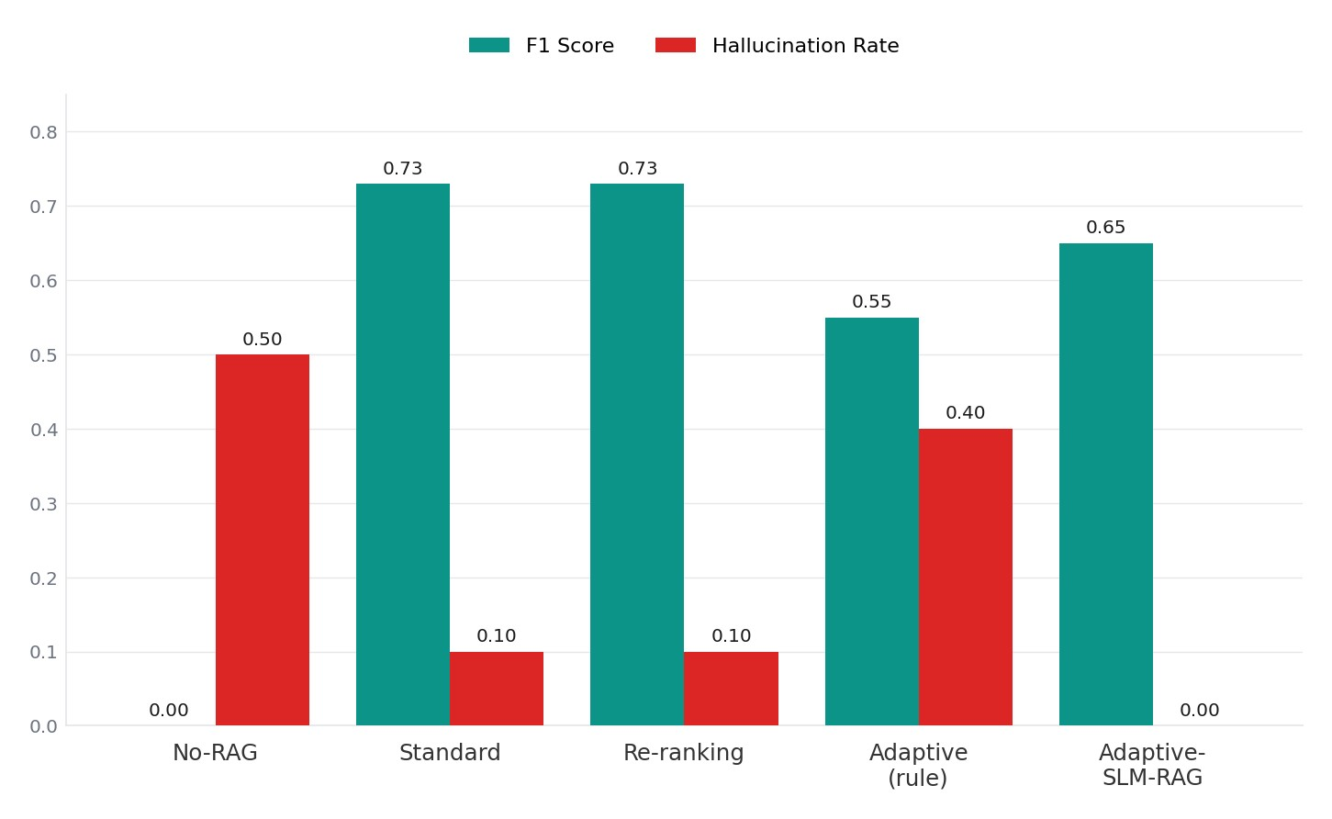
RESULTS — QUESTION ANSWERING
0%
hallucination on QA
1.6×
faster than rule-based
Adaptive-SLM-RAG matches Standard-RAG on F1 while eliminating hallucinations entirely. Rule- based Adaptive-RAG drops to 0.55 — fixed weights inject noise.

Slide 17
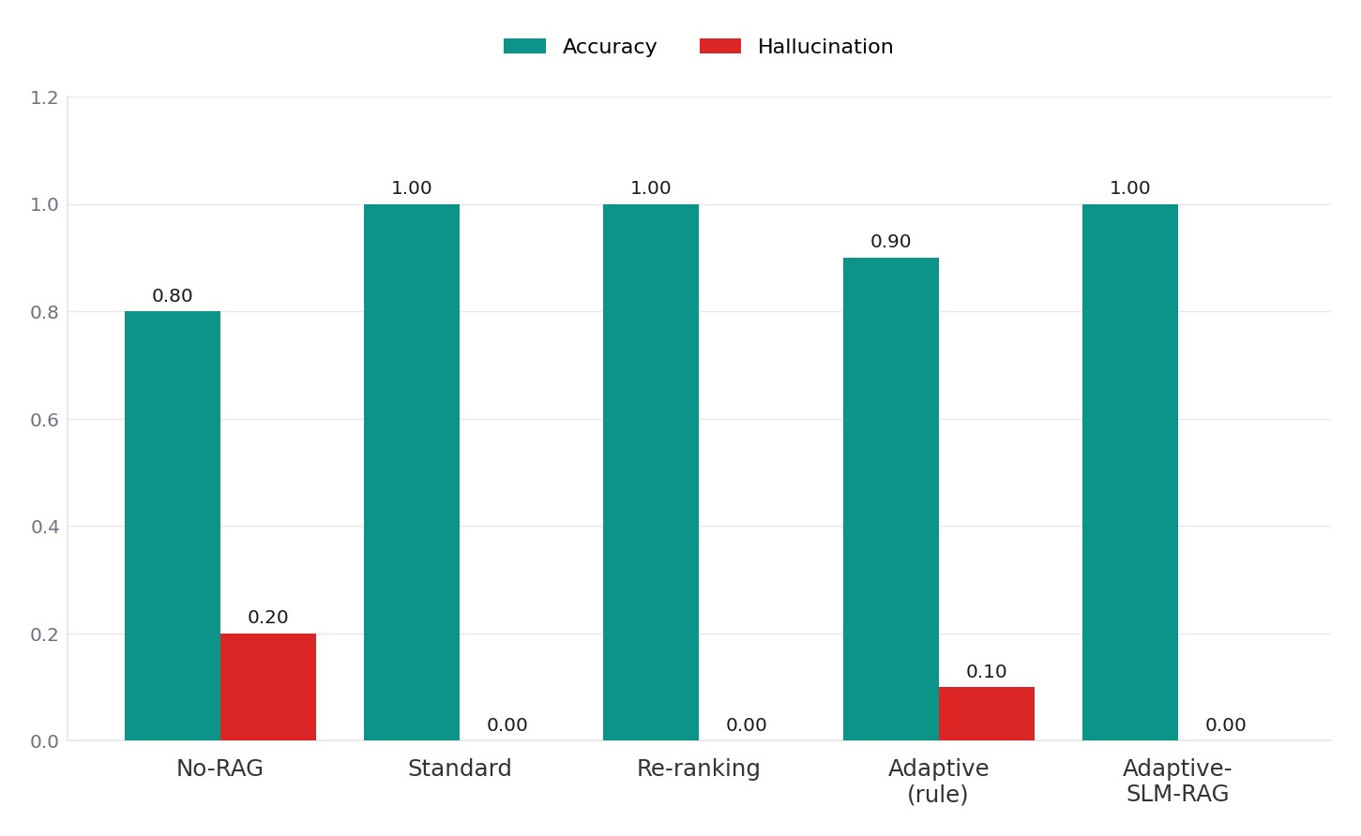
100%
RESULTS — SENTIMENT ANALYSIS
accuracy, zero halluc.
2.3×
faster (156ms vs 363ms)
Adaptive-SLM-RAG matches the best models on accuracy while running 2.3× faster than rule- based — the same predictor generalises with zero task-specific tuning.

Slide 18
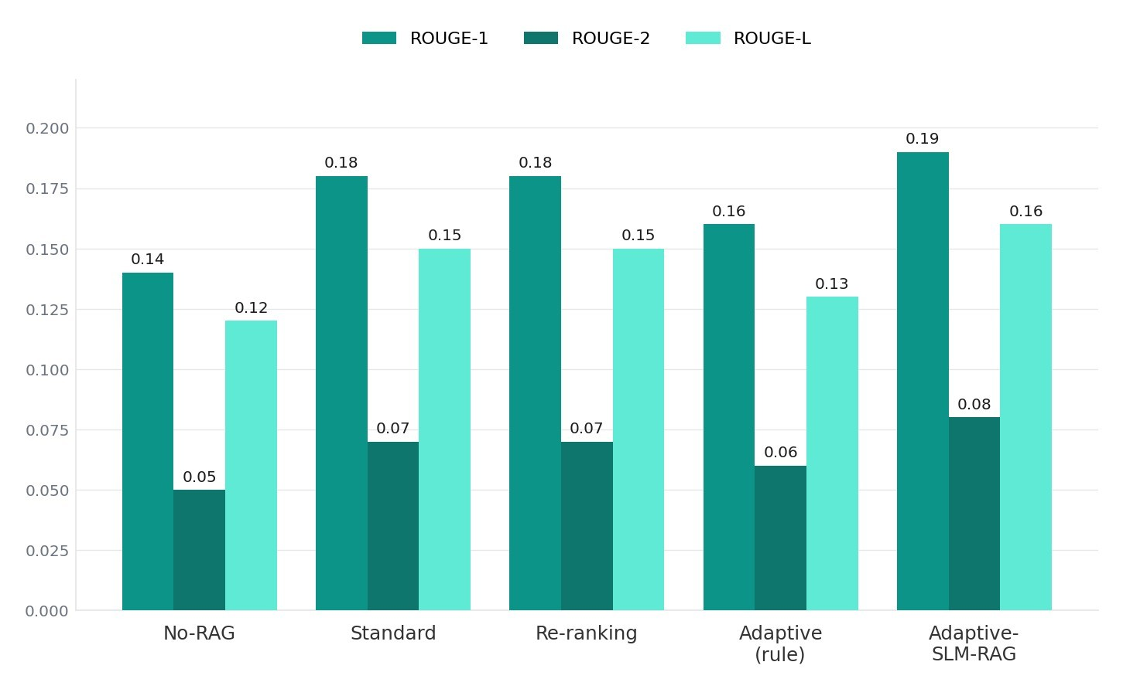
RESULTS — SUMMARISATION
0.19
ROUGE-1 (top score)
2.2×
faster (708ms vs 1533ms)
Adaptive-SLM-RAG hits the highest score on all three ROUGE metrics. Filtering low-confidence documents before generation yields tighter, more grounded summaries.

Slide 19
LATENCY — SPEED GAINS

Slide 20
COMPARATIVE ANALYSIS
Variant | QA F1 | Sentiment Acc | ROUGE-1 | Halluc. Rate | Notes
No-RAG | 0.00 | — | — | 0.50 | —
Standard RAG | 0.73 | 1.00 | 0.18 | 0.10 | Baseline
Re-ranking RAG | 0.73 | 1.00 | 0.18 | 0.10 | Baseline + reranker
Adaptive (rule) | 0.55 | 0.90 | 0.16 | 0.40 | Fixed weights fail
Adaptive-SLM-RAG | 0.65 | 1.00 | 0.19 | 0.00 | Best overall
The Adaptive-SLM-RAG row dominates: highest ROUGE-1, perfect sentiment accuracy, zero hallucination — and the fastest of the adaptive variants.

Slide 21
DISCUSSION — KEY FINDINGS
Multilingual matters
_{01 mu}Eng_{ltilingual}lish-only_{stack}NLP _{closes}tools (V_{that}ADE_{gap}R, e—tc.)_{full}fail_{en}o_{rich}n 40_{ment}–50%_{coverage}of Hindi,_{across}Tamil, T_{every}elugu_{languag}, and Be_{e}n_{we}gali_{ingest.}articles. The Wiser pipeline's
Fixed weights don't generalise
_{02 lo}Ru_{wer}le-b_{accuracy,}ased Adap_{lower}tive RA_{ROUGE,}G with h_{plus}and_{3–4×}-tuned_{highe}confid_{alr} e_{tency.}nce we_{The}ights_{failure}is bea_{mode}ten co_{is}ns_{consistent}istently by_{acro}simp_{ss}le_{all}r re_{three}trieva_{domains.}l models — lower F1,
Learned scoring wins
A 22M-parameter Sentence-Transformer encoder + 2-layer MLP head, trained on just 1,350 triples, beats hand-tuned weights on every metric — and runs 1.6–2.2× faster. No task-specific tuning was needed across QA, sentiment, or summarisation.
03

Slide 22
CONCLUSION
•
Delivered a three-phase contribution targeting the gaps in standard RAG pipelines across real-world multilingual and multi-task NLP applications.
Wiser pipeline: production-grade multilingual NLP enrichment at zero infrastructure cost, processing 25,000+ RSS feeds across six cadences.
•
•
Benchmark study: confirmed rule-based Adaptive RAG underperforms simpler baselines — fixed weights actively hurt generation quality.
Adaptive-SLM-RAG: lightweight learned confidence predictor (22M-param encoder + 2-layer MLP head trained on 1,350 triples) hits 0% hallucination on QA.
Cross-task efficiency: 1.6–2.2× faster than rule-based Adaptive RAG with no task-specific tuning of the predictor.
•
•
•
End-to-end: real-world multilingual ingestion → systematic evaluation → learned filtering yields a reproducible framework for multi-domain NLP.

Slide 23
FUTURE WORK
1 Large-scale training
Retrain on the full 93,738-entry QA corpus with balanced labels.
2 Dynamic thresholds
Learn task-specific filter thresholds via dev- set optimisation.
3 Cross-lingual RAG
Extend evaluation to Hindi / Tamil / Telugu / Bengali using LaBSE.
4 Generator upgrade
Move FLAN-T5-small → FLAN-T5-base or quantised Mistral-7B.
5 Wiser + ARCC integration
Wire learned filtering directly into the live Wiser article store.
6 Domain extension
Test on finance and healthcare retrieval — high-stakes settings.

Slide 24
REFERENCES
Lewis, P., Perez, E., Piktus, A. et al. (2020). Retrieval-Augmented Generation for Knowledge-Intensive NLP Tasks. NeurIPS.
Karpukhin, V., Oguz, B., Min, S. et al. (2020). Dense Passage Retrieval for Open-Domain Question Answering. EMNLP.
Izacard, G. & Grave, E. (2021). Leveraging Passage Retrieval with Generative Models for Open Domain QA. EACL.
Asai, A., Wu, Z., Wang, Y., Sil, A. & Hajishirzi, H. (2023). Self-RAG: Learning to Retrieve, Generate, and Critique through Self-Reflection. arXiv:2310.11511.
Gao, Y., Xiong, C., Gao, M. et al. (2023). Retrieval-Augmented Generation for Large Language Models: A Survey. arXiv:2312.10997.
Reimers, N. & Gurevych, I. (2019). Sentence-BERT: Sentence Embeddings using Siamese BERT-Networks. EMNLP.
Feng, F., Yang, Y., Cer, D., Arivazhagan, N. & Wang, W. (2022). Language-Agnostic BERT Sentence Embedding (LaBSE). ACL.
Khanuja, S. et al. (2021). MuRIL: Multilingual Representations for Indian Languages. arXiv:2103.10730.

Slide 25

THANK
YOU!
Questions?
HARSH DUBEY
2022UIT3012
PRISHA MALIK
2022UIT3030
HARSHIT GARG
2022UIT3038

